Slide 1
Android Learning-Based Application For Kids

Slide 2

Introduction
I AM HERE TO AID THE CHILDREN WITH ASD(Autism Spectrum Disorder)
LEARN AND PLAY!
INTERACT WITH ME
LET US GET SOCIAL !

Slide 3
Objective
Create a mobile platform for children with ASD(Autism Spectrum Disorder) to assist them improve their social skills and socially appropriate behaviors through Social Stories and other visual prompts.

Slide 4
Motivation
The Traditional visual schedules available for Android platform are cumbersome, expensive and limited in function.

Slide 5
Technology
USERS
Mobile Platform : Android
Android API Level : 5.0 or above
Minimum RAM size : 2GB
DEVELOPERS
Android Studio
Eclipse
Windows with JAVA 8 installed

Slide 6
End Users
Children with ASD
Guardian
Mentor

Slide 7
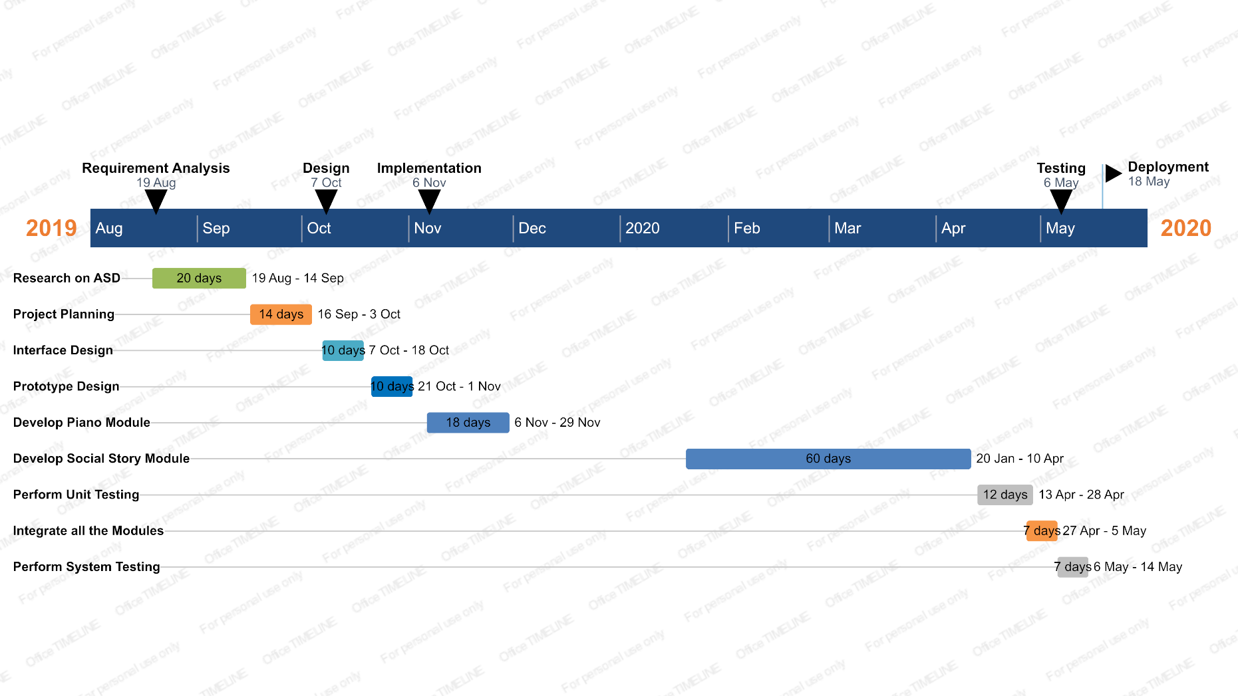
Gantt Chart

Slide 8
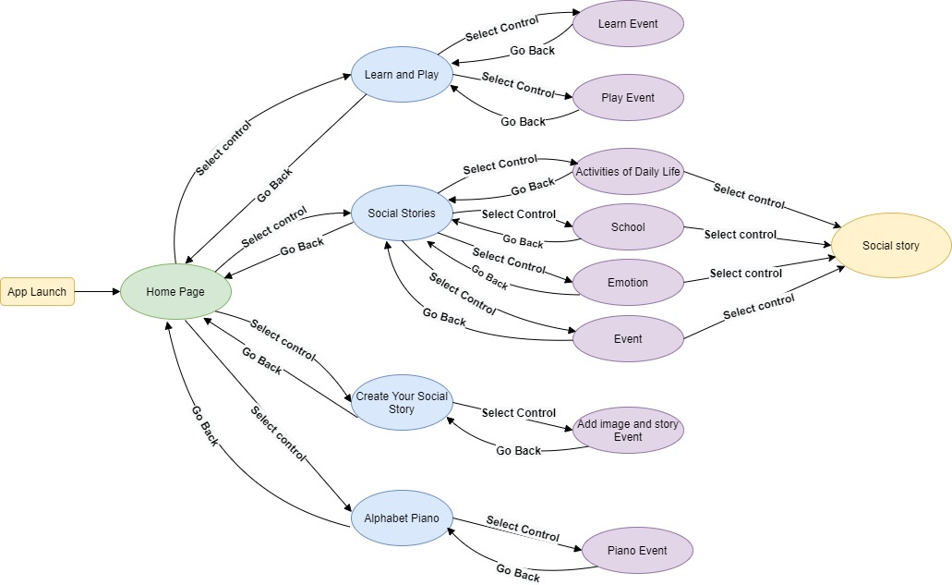
Flow of Control in Project

Slide 9
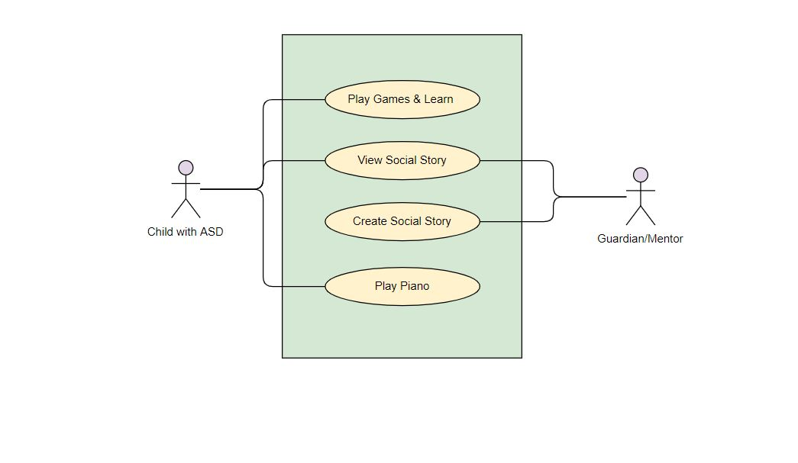
Use Case Diagram

Slide 10
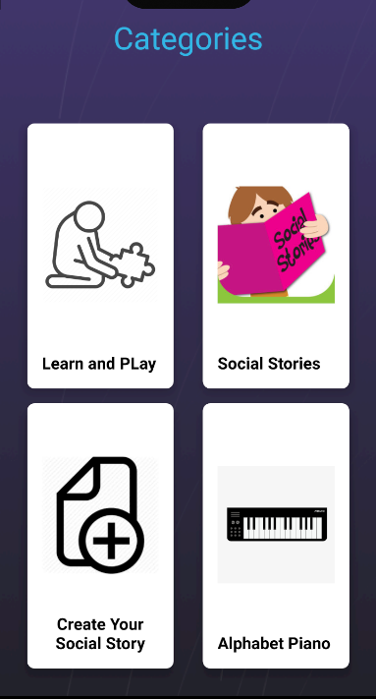
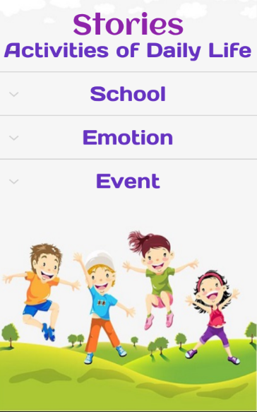
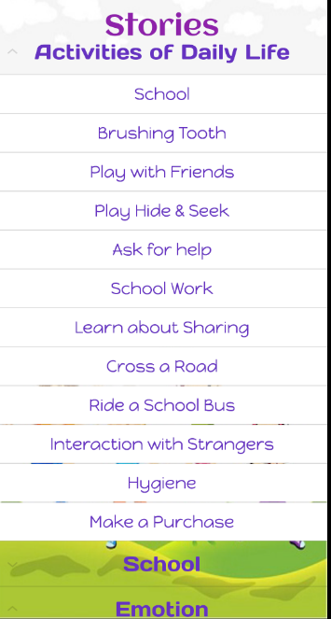
Screenshots

Slide 11
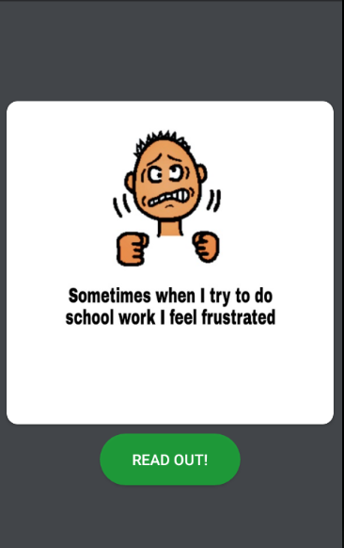
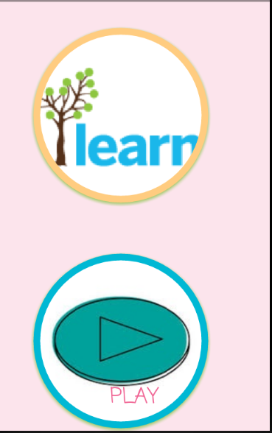
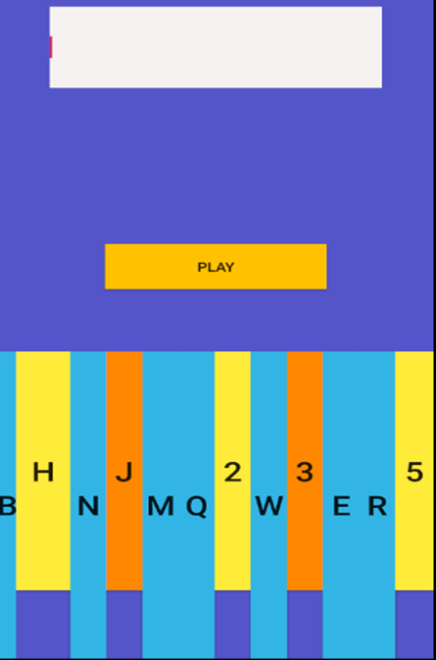
Screenshots(Contd.)

Slide 12

Conclusion
This application will help many children live a better life, which is a service to society.
It fulfils some shortcomings of modern education system for children.
This will make some modern education tools available for not so financially strong individuals.

Slide 13
Future Scope
For individuals with ASD, mobile technology can be used effectively for not only entertainment and as an augmentative and alternative communication (AAC) device, but also to assist in teaching academic areas, social skills, video modeling, reinforcement, ABA, speech/language therapy, fine motor skills, visual supports, functional life skills, organizational skills, and increasing independence.

Slide 14
Thank You

Slide 15
Presented by
PRIYA ROY (Roll no.-12200116044)
RISHAB PRASAD (Roll no.-12200216027)
SANGITA POREY (Roll no.-12200117002)

